Slide 1

PROPOSAL
DREAMTEAM
VOX MAPP
Notes:
Bonjour, nous sommes l'équipe "dream team", ce projet est né grâce a ma soeur qui a eu la chance de travailler dans l'entreprise VoxMapp, plus précisément avec les bases de données. j'ai eu la chance de prendre la matière de "relational data bases" avec laquelle je essairé de résoudre votre problémes détectéé dans l' entretien et je vais expliquer comment un système de bases de données relationnelle peut résoudre ces problèmes.

Slide 2
PROBLEMS TO SOLVE
HARD DATA BASE CLEANING PROCESSES
TIME COSTLY ANALYTIC PROCESSES
HARD MONITORING BRIEFS CREATION
Notes:
we catalogued tree main problems extracted from the interview. right now voxmap has

Slide 3

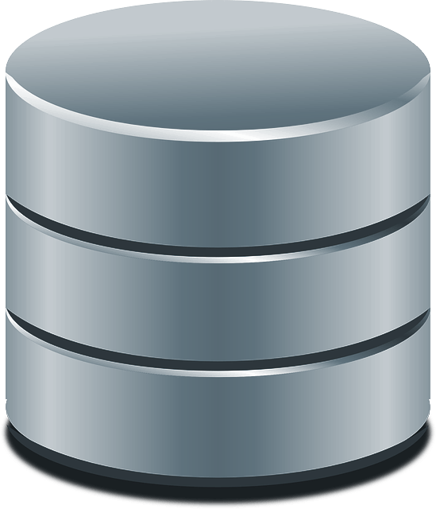
HARD DATA BASE CLEANING PROCESSES
RELATIONAL DB
NORMALIZATION
3RD NF
PRODUCTION
Notes:
FIRST LET’S TALK ABOUT cleaning. IN THE SHORT INTERVIEW HELD karla mentions 8 different cleaning processes she has to go through.
Now thos cleaning process would not be necesary if the primary data inserttion from the app was correctly done.
The first thing, as data ingineers we notice that your data is NOT NORMALIZED. Now this is a sin for databases because this means that the data will need to go through cleaning processes.
so we analysed the data you gave us and put it throught a process called normalization,
there are 7 normalization rules but once you get your data through the 3rd normalization process, you are ready for production
So we did that with the data available and came up with this solution

Slide 4
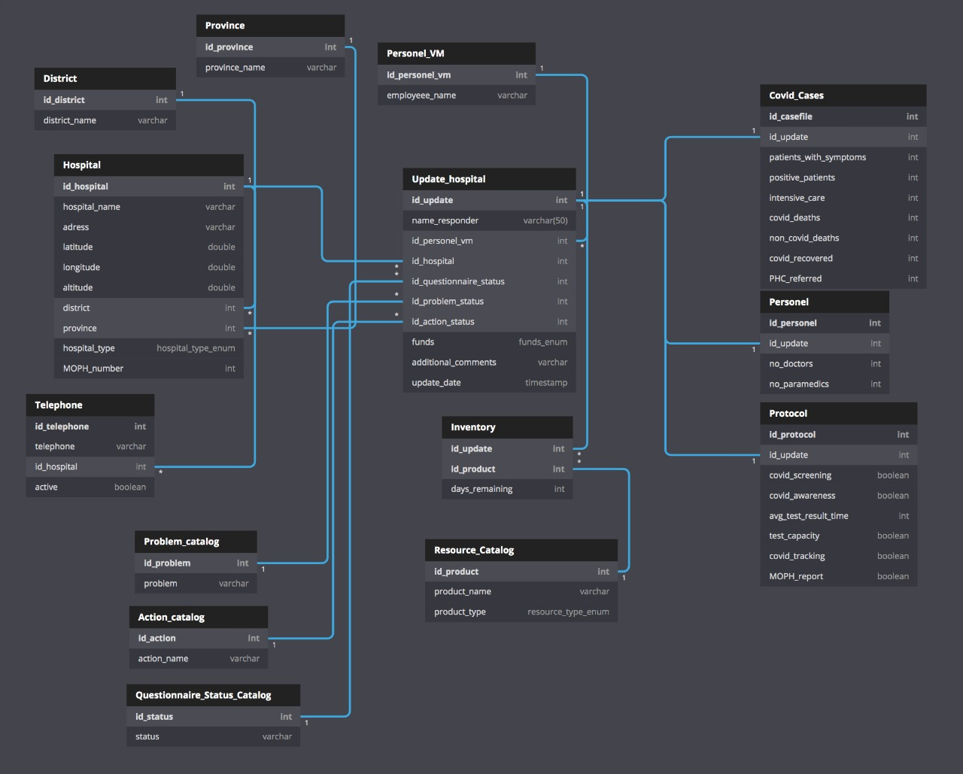
Notes:
This specific way of organizing the data, allows for the correct ordering, analizing and extraction of the data.

Slide 5
HARD DATA BASE CLEANING PROCESSES
SOLUTIONS
Single answer column
1st NF - insertion boundaries
Phone LADA’s
app LADA, entity PHONE
+/- phone digits
app regulation
province
entity PROVINCE + dropdown
complete / incomplete questionnaires
app regulation +
views
problem / solution
views + app autocomplete
Notes:
FIRST LET’S TALK ABOUT cleaning. IN THE SHORT INTERVIEW HELD karla mentions 8 different cleaning processes she has to go through.
Now thos cleaning process would not be necesary if the primary data inserttion from the app was correctly done.
The first thing, as data ingineers we notice that your data is NOT NORMALIZED. Now this is a sin for databases because this means that the data will need to go through cleaning processes.
so we analysed the data you gave us and put it throught a process called normalization,
there are 7 normalization rules but once you get your data through the 3rd normalization process, you are ready for production
So we did that with the data available and came up with this solution

Slide 6
THANK YOU !
VOX MAPP

